Slide 1
Greatness in the Kingdom
Kingdom Character
(Matt 5:1-12)
Kingdom
Calling
(Matt 5:13-16)
Kingdom Conduct
(Matt 5:17-7:27)

Slide 2
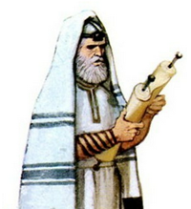
Greatness in the Kingdom
exceed that
of Scribes and Pharisees …
(Matthew 5:20)
not done like hypocrites to be seen by others
(Matthew 6:1-2)
warnings against worldliness
(Matthew 6:19-7:27)
Kingdom Righteousness Explored

Slide 3
Greatness in the Kingdom
Guard your heart
above all else, for it determines the
course of your
life.
(Proverbs 4:23)
The eyes of the Lord search the whole earth in order to strengthen those whose hearts are fully committed to him.
(2 Chronicles 16:9)
Kingdom Righteousness Explored

Slide 4
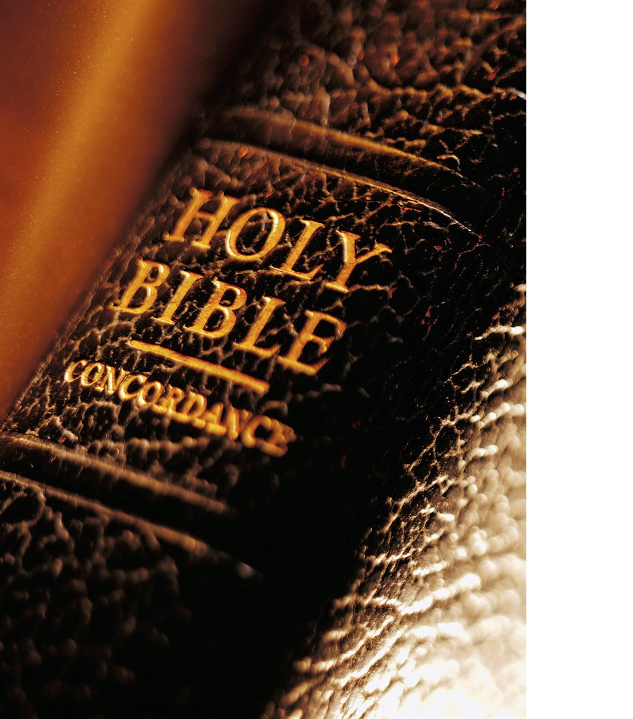
Matthew 6:19-34 (NLT)
¹⁹ “Don’t store up treasures here on earth, where moths eat them and rust destroys them, and where thieves break in and steal. ²⁰ Store your treasures in heaven, where moths and rust cannot destroy, and thieves do not break in and steal. ²¹ Wherever your treasure is, there the desires of your heart will also be.

Slide 5
Matthew 6:19-34 (NLT)
²² “Your eye is a lamp that provides light for your body. When your eye is good, your whole body is filled with light. ²³ But when your eye is bad, your whole body is filled with darkness. And if the light you think you have is actually darkness, how deep that darkness is!

Slide 6
Matthew 6:19-34 (NLT)
²⁴ “No one can serve two masters. For you will hate one and love the other; you will be devoted to one and despise the other. You cannot serve both God and money. ²⁵ “That is why I tell you not to worry about everyday life —whether you have enough food and drink, or enough clothes to wear. Isn’t life more than food, and your body more than clothing?

Slide 7
Matthew 6:19-34 (NLT)
²⁶ Look at the birds. They don’t plant or harvest or store food in barns, for your heavenly Father feeds them. And aren’t you far more valuable to him than they are? ²⁷ Can all your worries add a single moment to your life? ²⁸ “And why worry about your clothing? Look at the lilies of the field and how they grow. They don’t work or make their clothing,

Slide 8
Matthew 6:19-34 (NLT)
²⁹ yet Solomon in all his glory was not dressed as beautifully as they are. ³⁰ And if God cares so wonderfully for wildflowers that are here today and thrown into the fire tomorrow, he will certainly care for you. Why do you have so little faith? ³¹ “So don’t worry about these things, saying, ‘What will we eat? What will we drink? What will we wear?’

Slide 9
Matthew 6:19-34 (NLT)
³² These things dominate the thoughts of unbelievers, but your heavenly Father already knows all your needs. ³³ Seek the Kingdom of God above all else, and live righteously, and he will give you everything you need. ³⁴ “So don’t worry about tomorrow, for tomorrow will bring its own worries. Today’s trouble is enough for today.

Slide 10
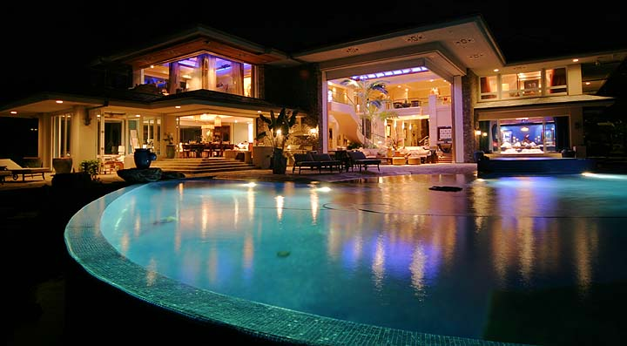
Greatness in the Kingdom
Do not store
up treasures
here on earth
(Matthew 6:19)
Attachment
Warnings against Worldliness

Slide 11
Greatness in the Kingdom
The 4 Lies of Consumerism
My stuff makes me …
happy
important
secure
rich
Warnings against Worldliness

Slide 12
Greatness in the Kingdom
For where your treasure is, there your heart will be also.
(Matthew 6:21)
Warnings against Worldliness

Slide 13
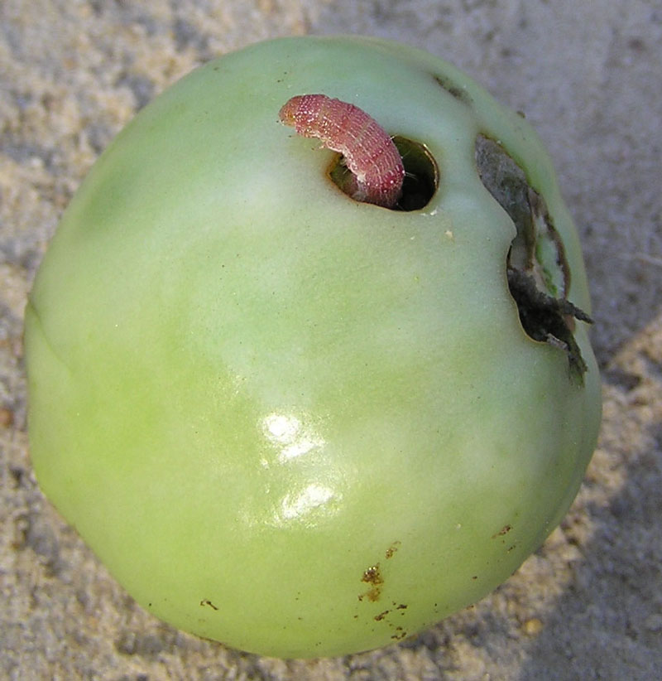
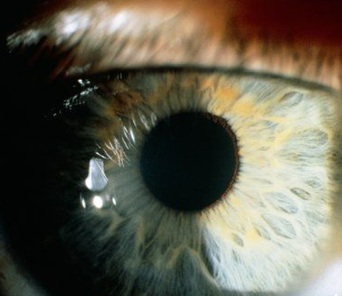
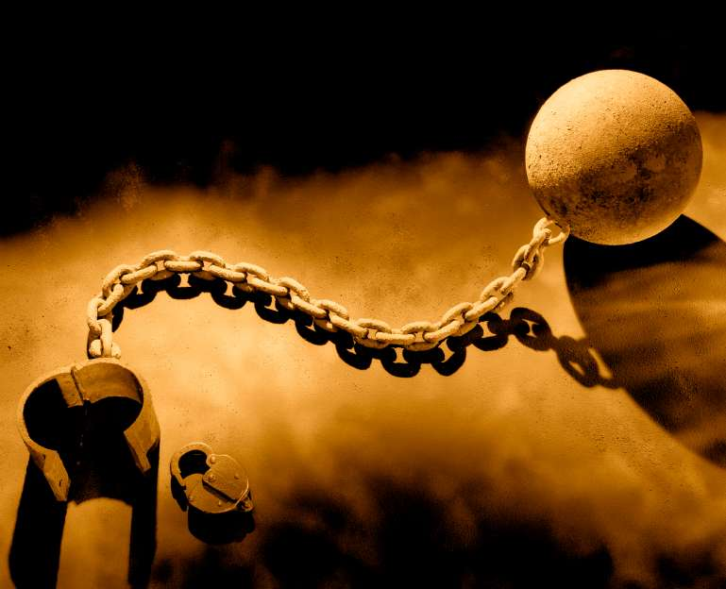
Greatness in the Kingdom
decays
(Matt 6:19)
stolen
(Matt 6:19)
corrupted
(Matt 6:23)
enslaves
(Matt 6:19)
Warnings against Worldliness

Slide 14
Greatness in the Kingdom
Anxiety
Do not be
anxious about
your life
(Matthew 6:25,31,34)
Warnings against Worldliness

Slide 15
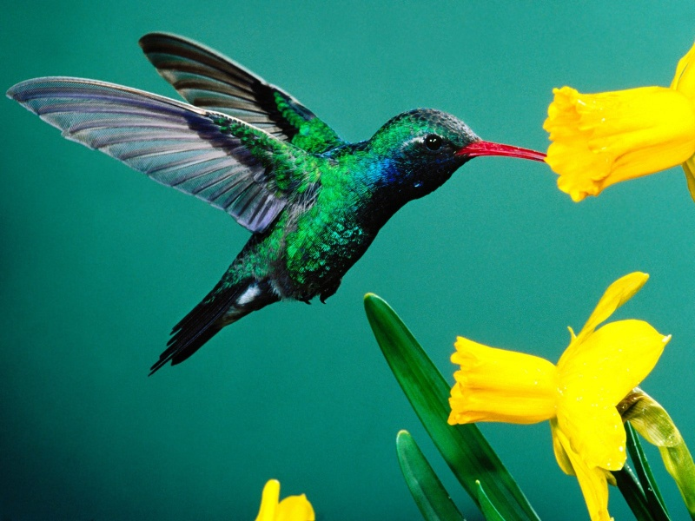
Greatness in the Kingdom
Learn from flowers.
God clothes them.
Much more you!
(Matt 6:28-30)
Consider the birds.
Father feeds them.
You matter more!
(Matt 6:26)
Warnings against Worldliness

Slide 16
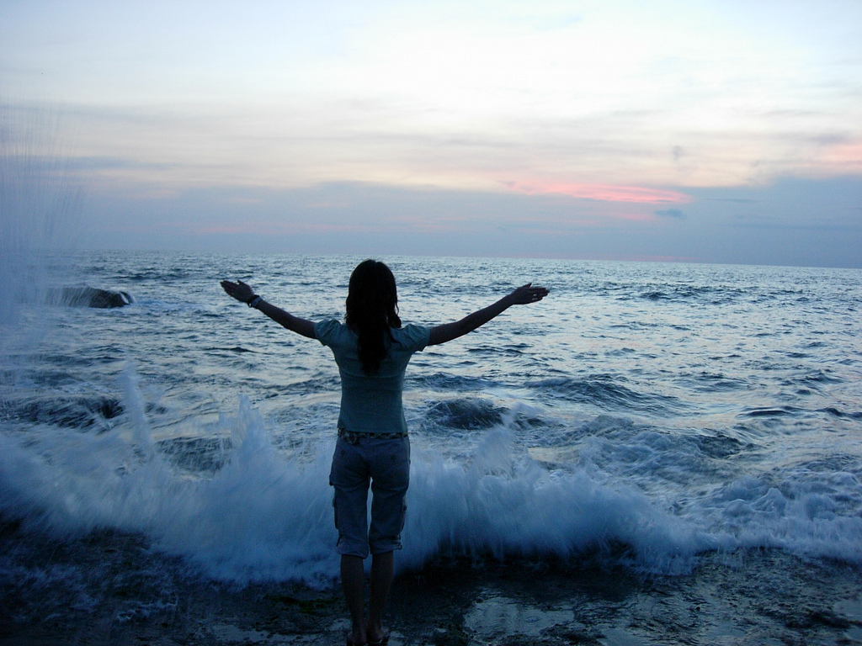
Greatness in the Kingdom
Life is more than food and clothing!
(Matthew 6:25)
Warnings against Worldliness

Slide 17
Greatness in the Kingdom
Kindness
Character
… So …
Invest in
heavenly
treasures!
(Matthew 6:20)
Warnings against Worldliness

Slide 18
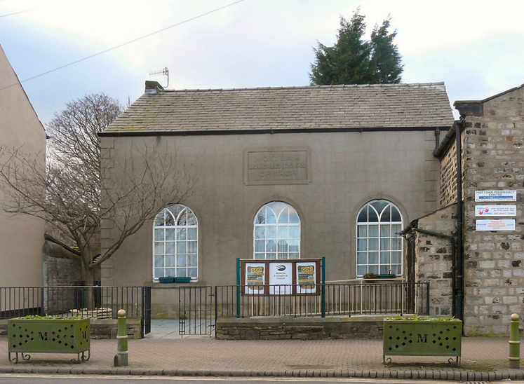
Greatness in the Kingdom
Life is more than
the here and now!
(Matthew 6:33)
Warnings against Worldliness

Slide 19
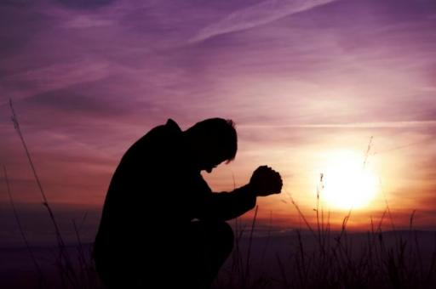
Greatness in the Kingdom
… So …
Seek
heavenly priorities
(Matthew 6:33)
The Kingdom
Righteousness
Warnings against Worldliness

Slide 20
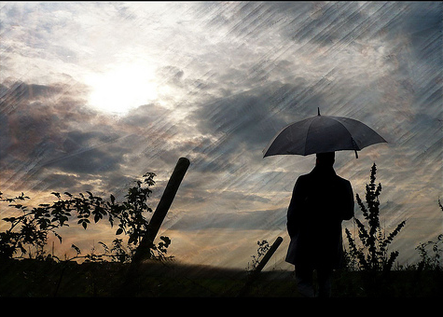
Greatness in the Kingdom
Life does have daily troubles …
(Matthew 6:34)
Warnings against Worldliness

Slide 21
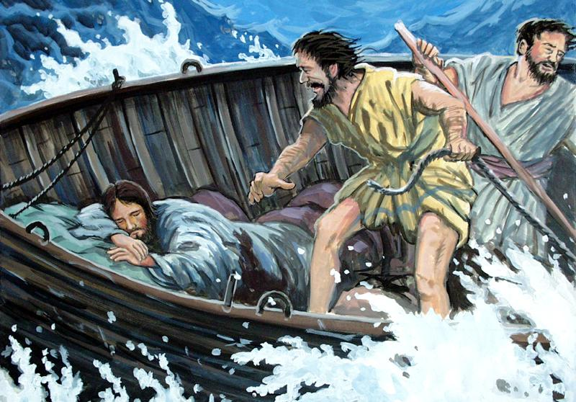
Greatness in the Kingdom
Do you still have no faith?
(Mark 4:40)
Warnings against Worldliness

Slide 22
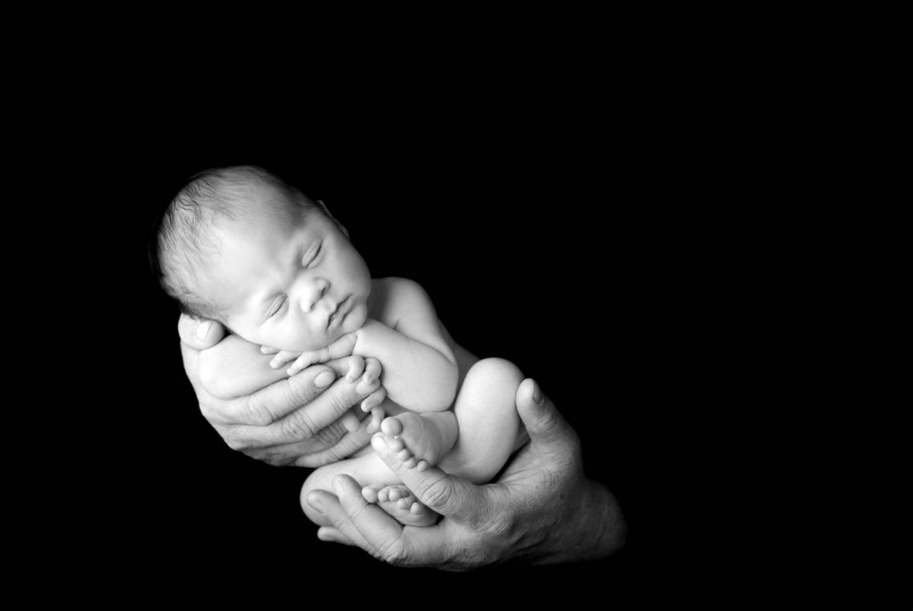
Greatness in the Kingdom
… So …
Trust your heavenly Father
(Matthew 6:32)
grow in faith
Warnings against Worldliness

Slide 23
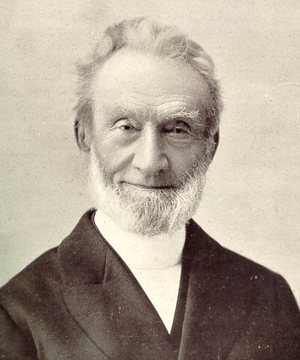
Greatness in the Kingdom
If we desire our faith to be strengthened, we should not shrink from opportunities where our faith may be tried, and therefore, through trial, strengthened.
(George Muller)
Warnings against Worldliness

Slide 24
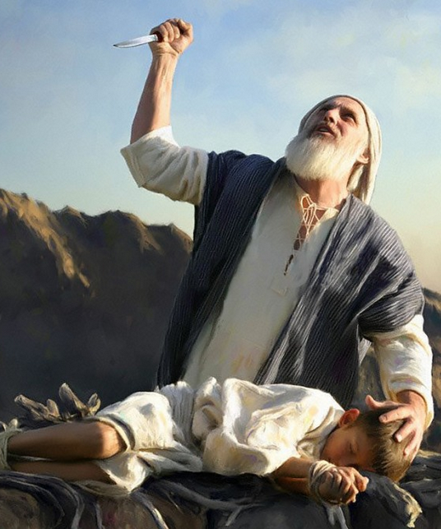
Greatness in the Kingdom
It is impossible to please God without faith. Anyone who wants to come to him must believe that God exists and that he rewards those who diligently seek him.
(Hebrews 11:6)
Warnings against Worldliness

Slide 25
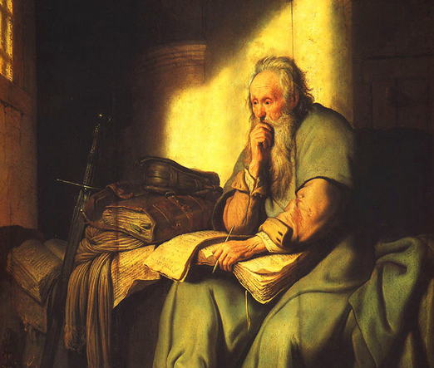
Greatness in the Kingdom
I have learned the secret of living in
every situation, whether it is with
a full stomach or empty, with plenty or little.
(Philippians 4:11-13)
Warnings against Worldliness

Slide 26
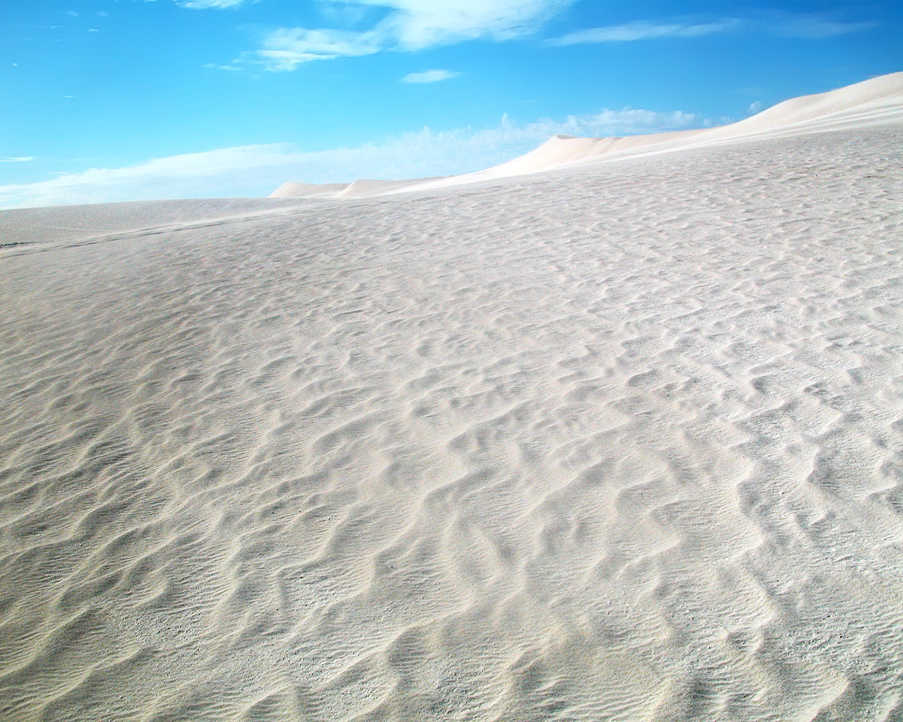
Greatness in the Kingdom
Avoid Worldly Attraction & Anxiety
Invest in Heavenly Treasures
Seek Heavenly Priorities
Trust Your Heavenly Father
Warnings against Worldliness

